Slide 1
Regis University Border Crossing Visualization and Analysis
Olufemi Babalola
MSDS692_40B_Data Science Practicum I 6/24/2020

Slide 2
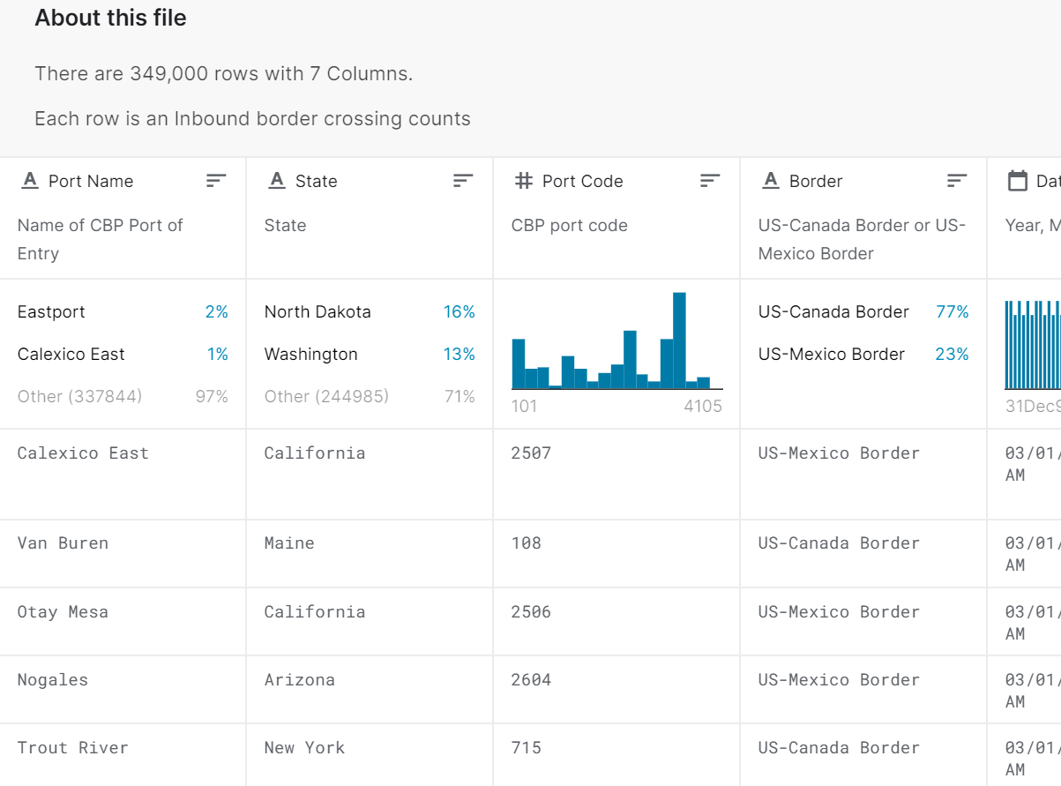
THE DATASET
The dataset is provided by the Bureau of Transportation Statistics (BTS) and covers the incoming vehicle, container, passenger, and pedestrian counts at U.S.-Mexico and U.S.-Canada land border ports.

Slide 3
Dataset description
The data reflects the number of vehicles, containers, passengers or pedestrians entering the United States.
Border: Identifies which border was crossed
Date: Timestamp indicating month and year of crossing
Measure: Indicates the mode of transportation in border crossing being measured
Value: indicates the total number of crossings

Slide 4
OBJECTIVE
This study is focused on analyzing US Border Crossings viz a viz to identify which country is most associate US Border Crossings. Which US States is mostly use by illegal immigrants? Which are the busiest Ports? What mode of transport are employed? How many vehicles, boats and pedestrians cross into the US, weekly, monthly, and yearly? Which season of the year has a greater number of crossings?

Slide 5
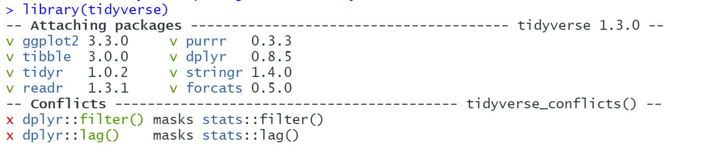
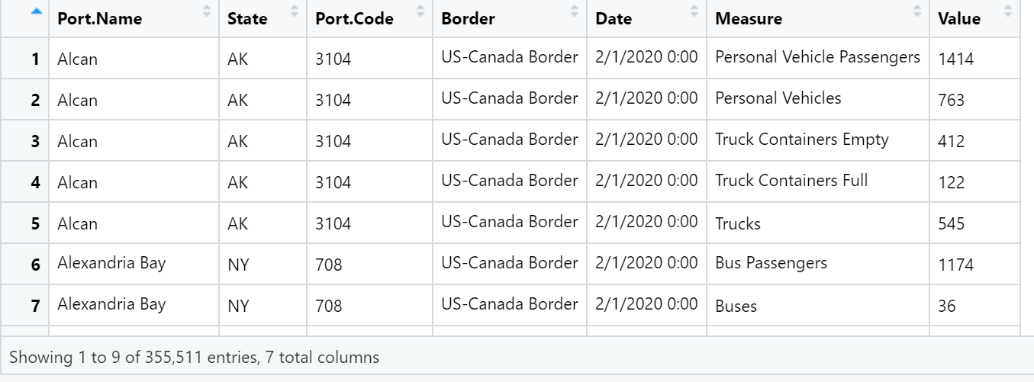
IMPORTING THE DATASET

Slide 6
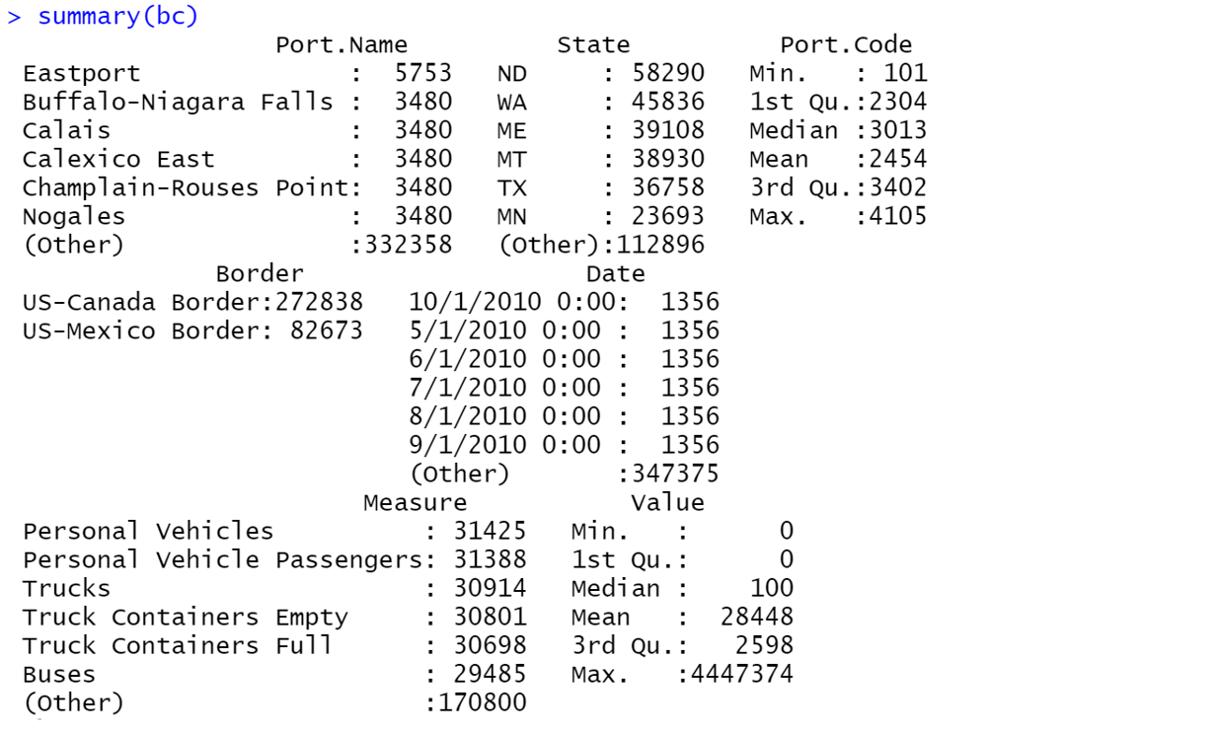
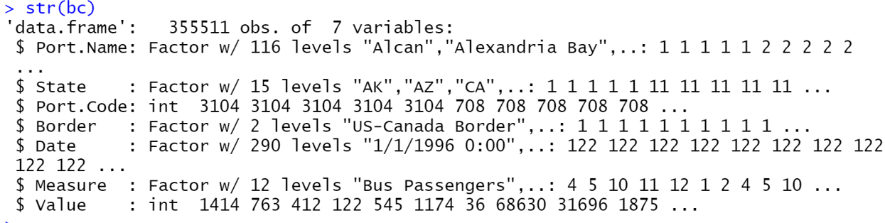
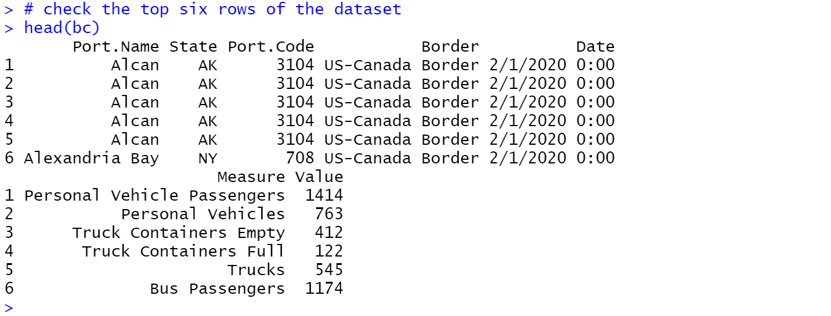

EXPLORATORY ANALYSIS
We see the dataset consist of 7 variables including Port.Name, State, Port.Code, Border, Date, Measure and Value.
Looking at the structure, we observe that this is a data frame with 355511 observations and 7 variables.
There are no missing values.

Slide 7
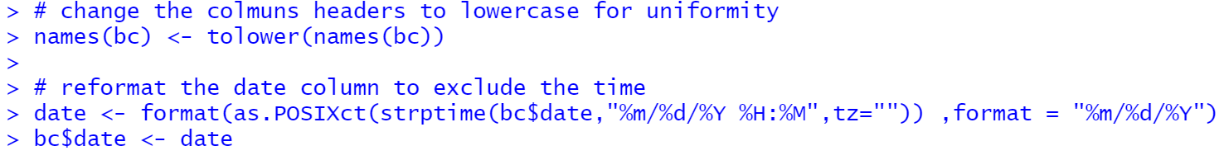
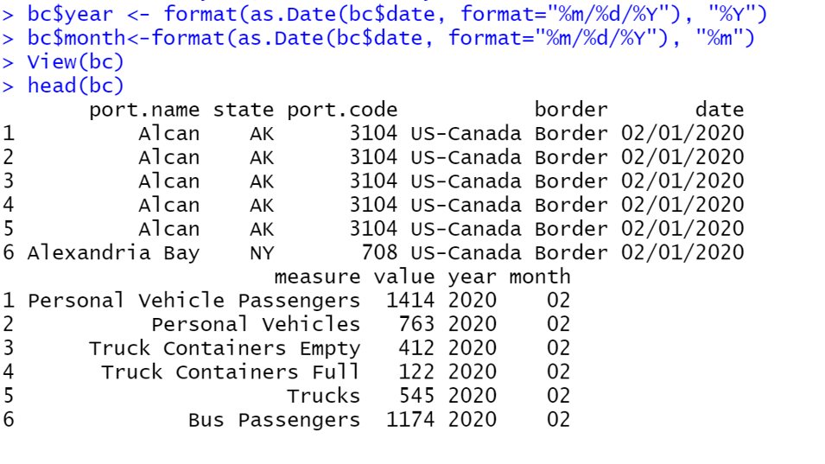
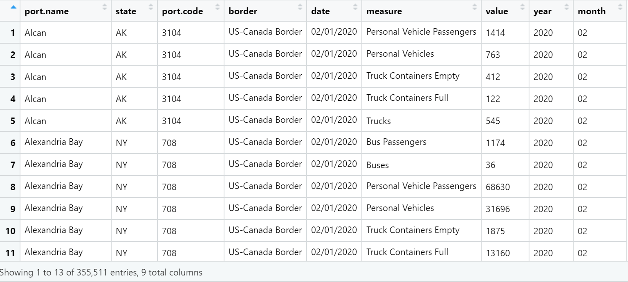
REFORMATING THE DATE

Slide 8
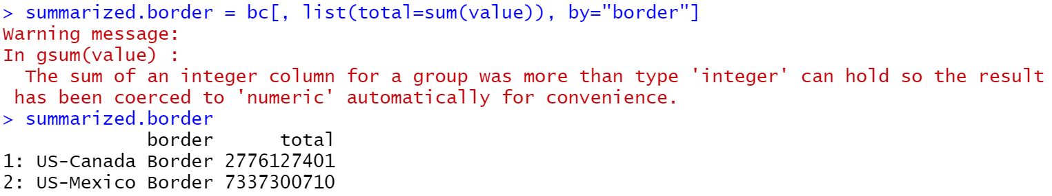
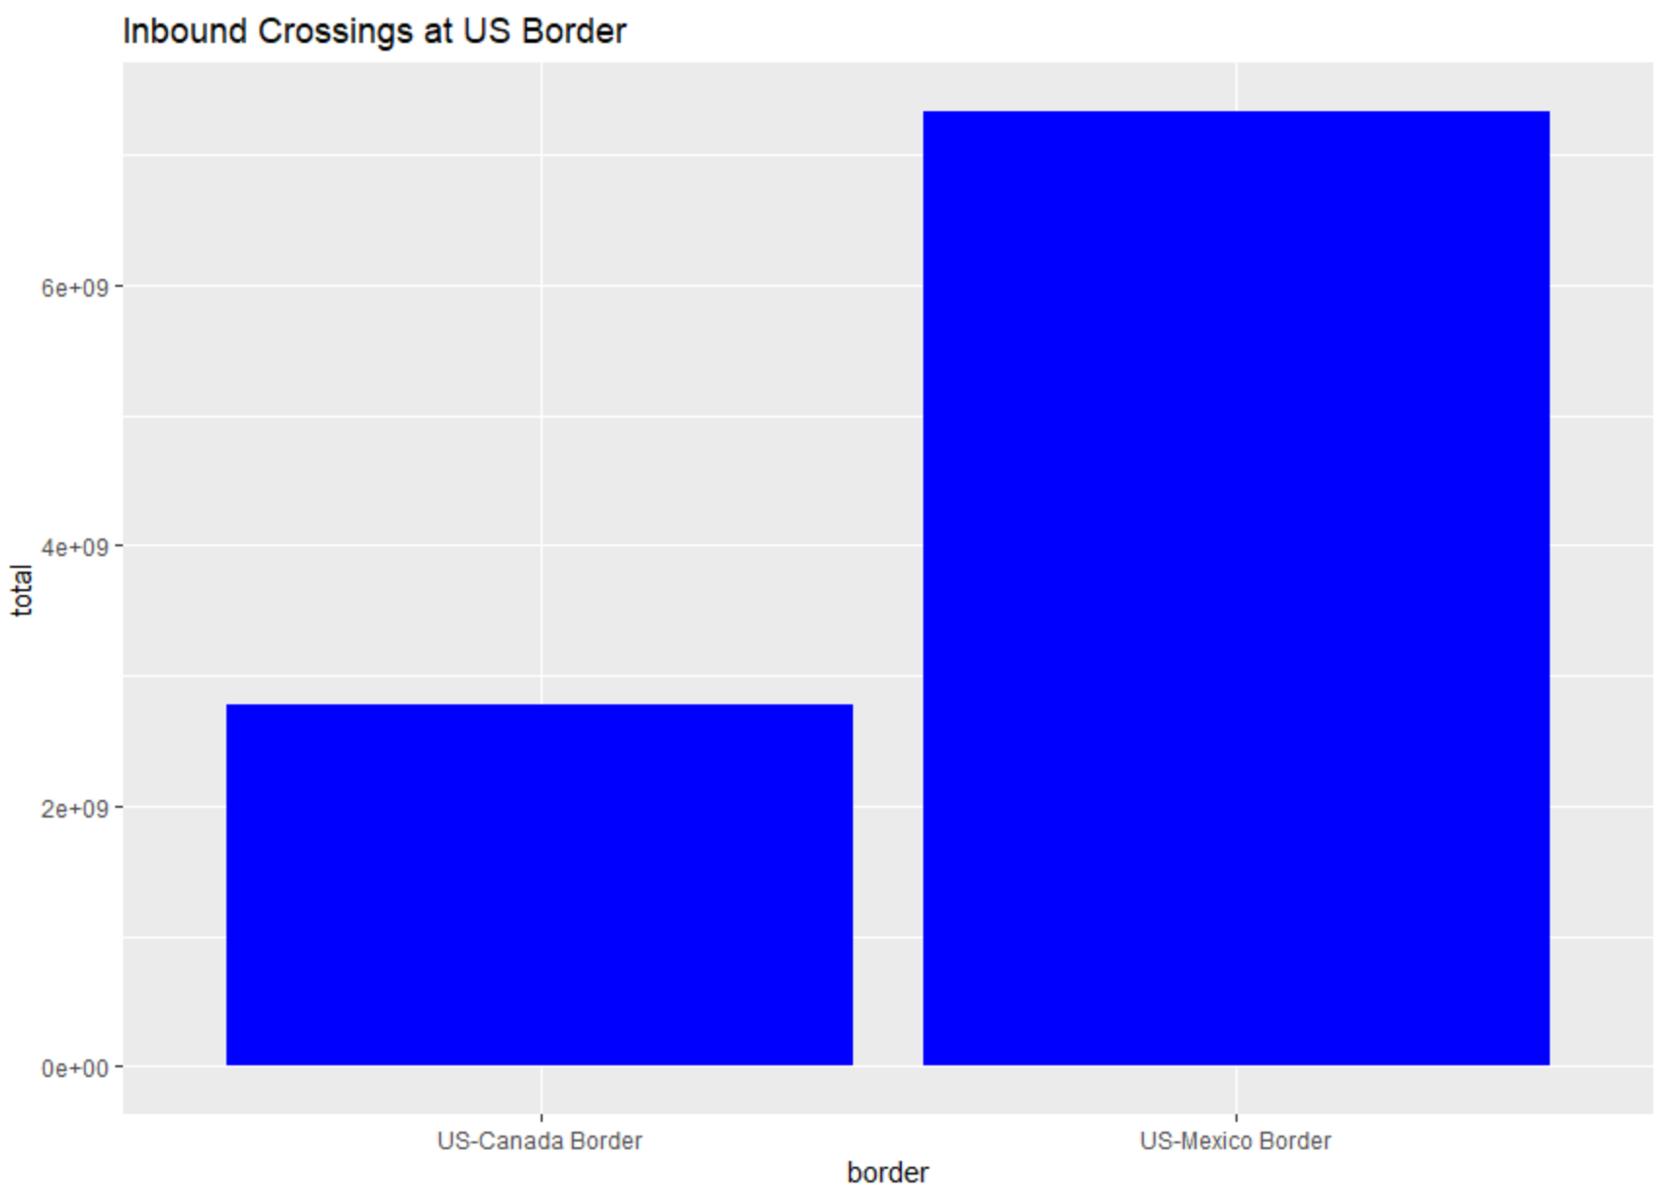
Inbound Crossings at US Border
From here, we noticed that 73.3 percent of total inbound crossing occurs at US-Mexico Border.

Slide 9
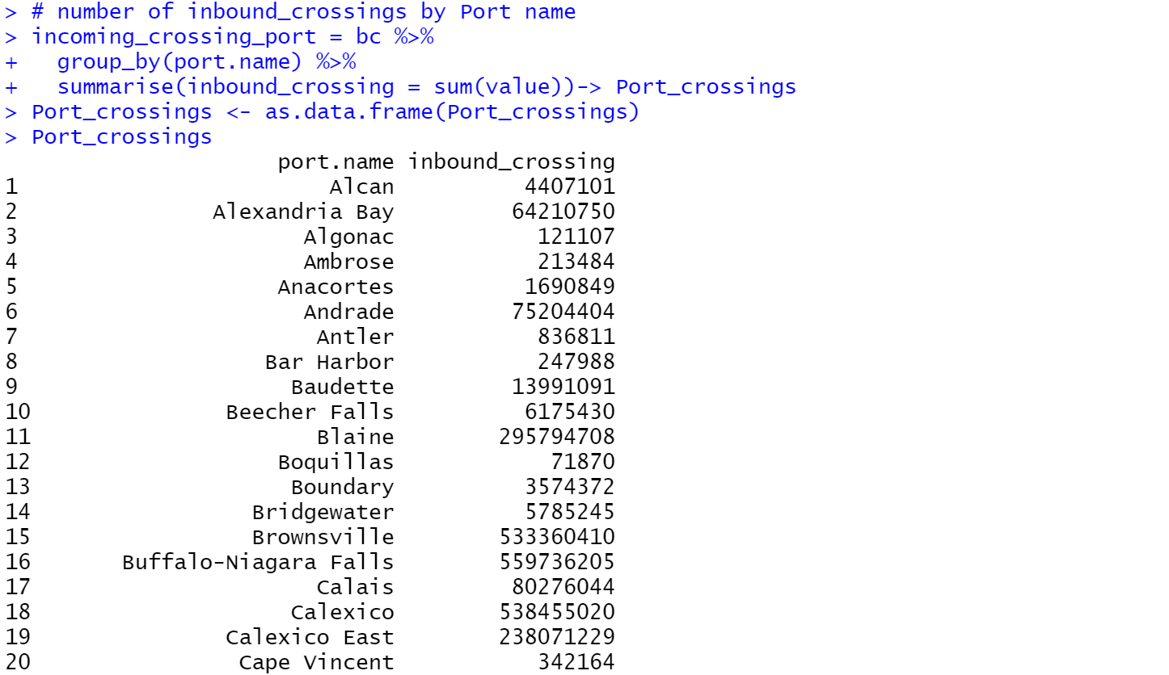
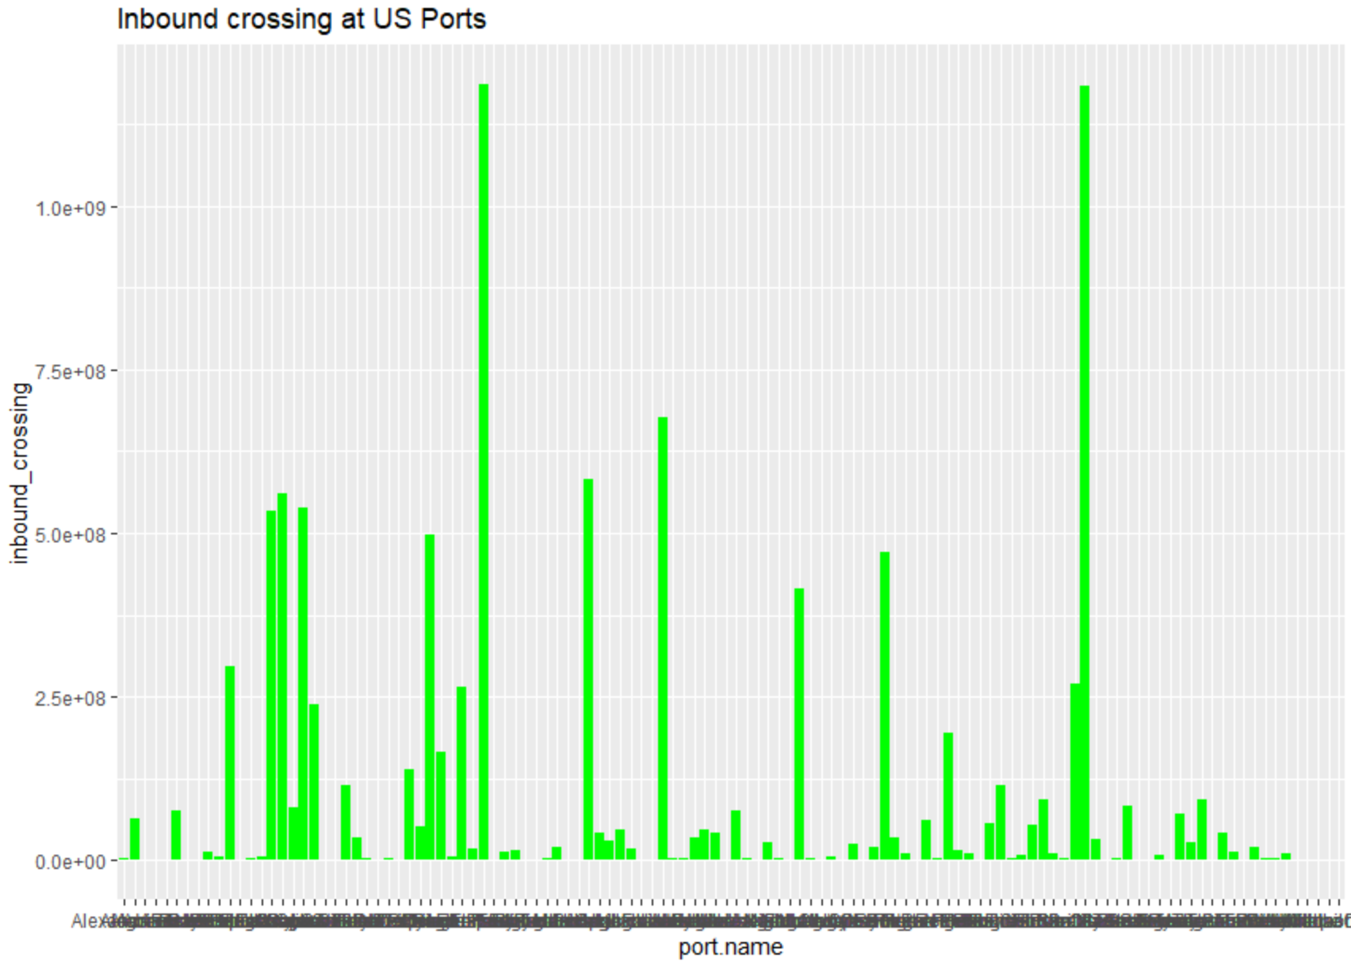
Inbound Crossing at US Ports
Next, I would like to see the number of inbound crossing at the various ports at US Border.
This list runs through 116 ports.

Slide 10
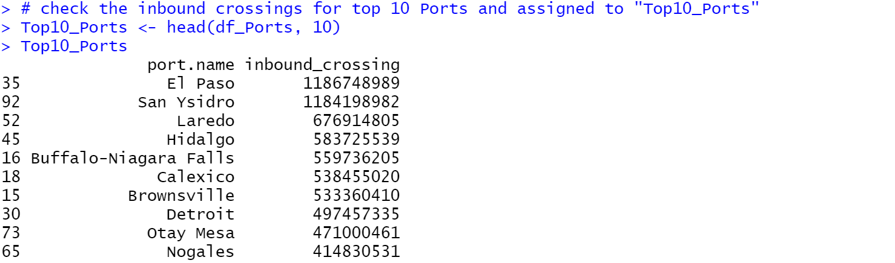
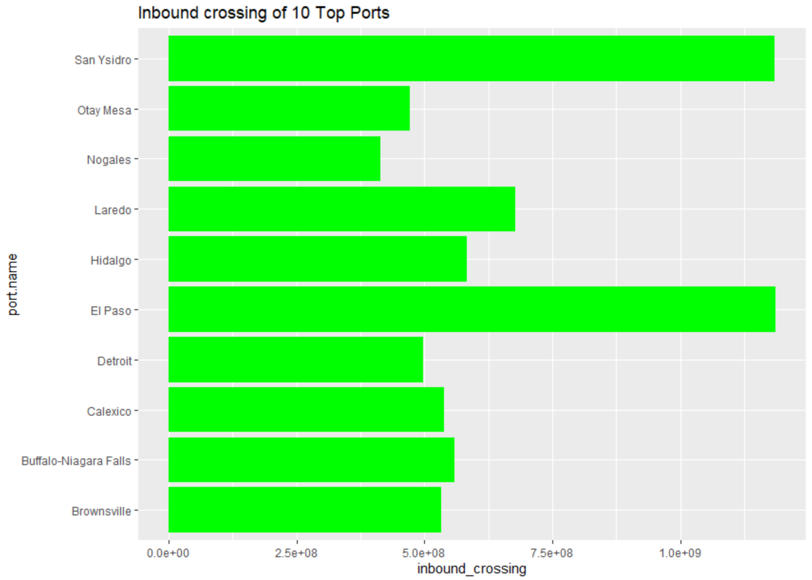
Top Ten Ports
To rank the data in terms of the port with the most traffic, we sort 116 ports in descending order, and we check for the top ten ports.
We observe most of the crossing takes place at El Paso port followed by San Ysidro and Laredo. To my surprise, Detroit is number seven on the list.

Slide 11
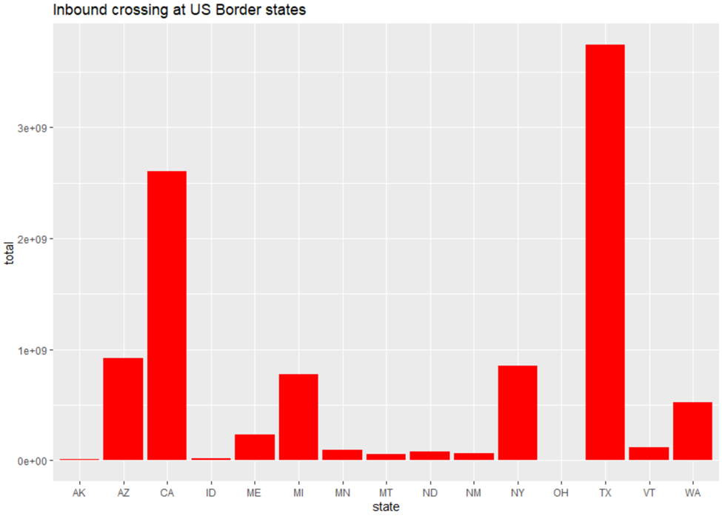
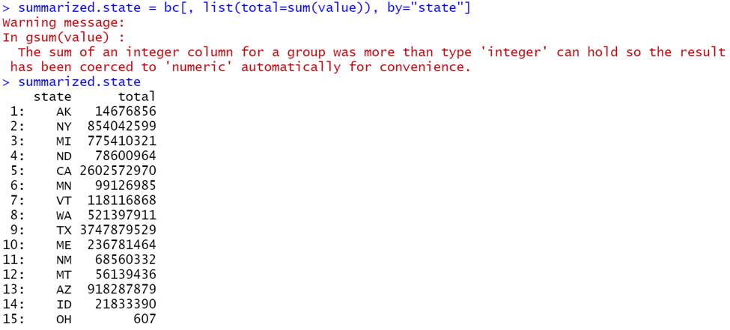
Inbound Traffic at US Border States
From the data drawn, we observe that Texas has the most inbound traffic followed by California.

Slide 12
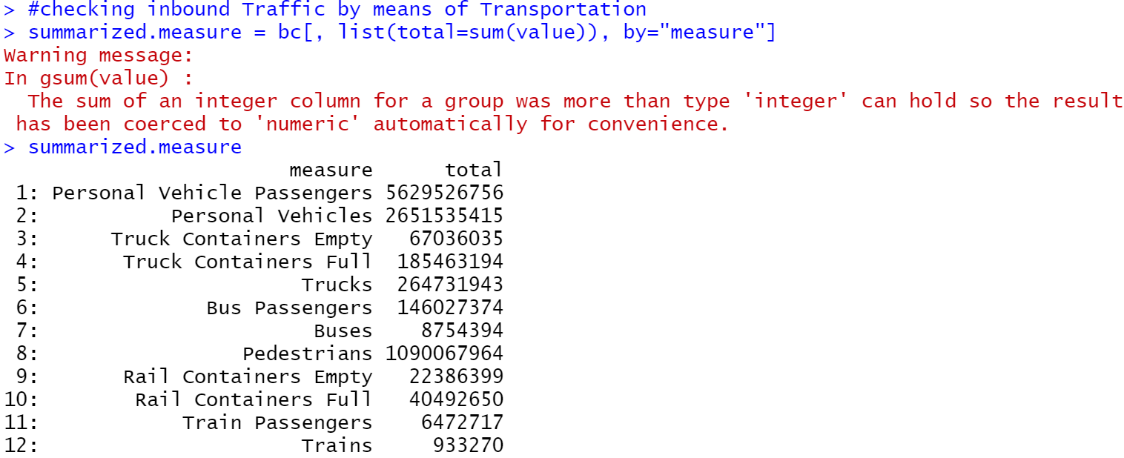
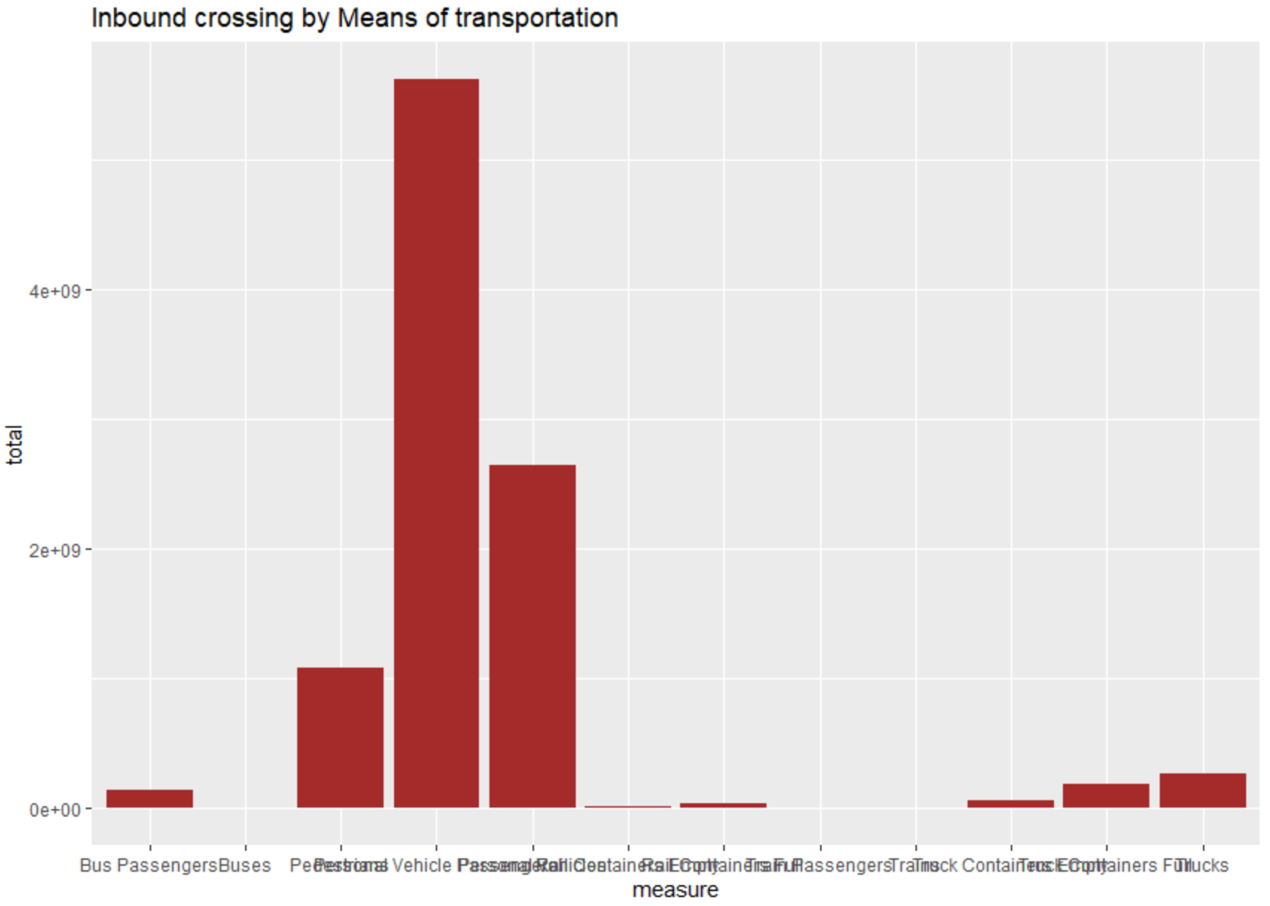
Inbound Traffic by Means of Transportation
Here from the data retrieved, we see the most used mode of transportation were with personal vehicle passengers.

Slide 13
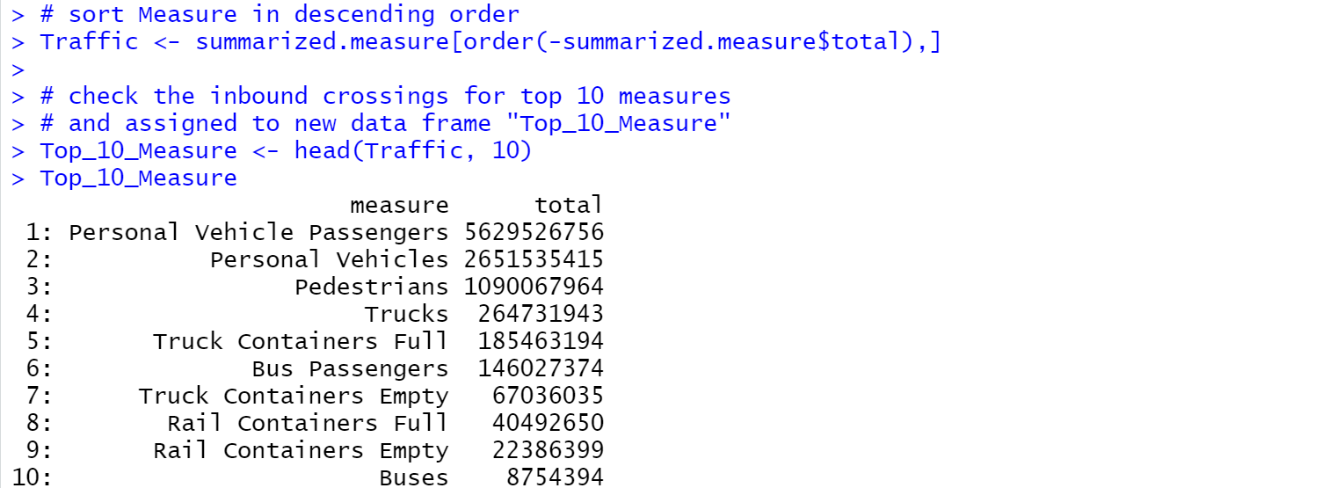
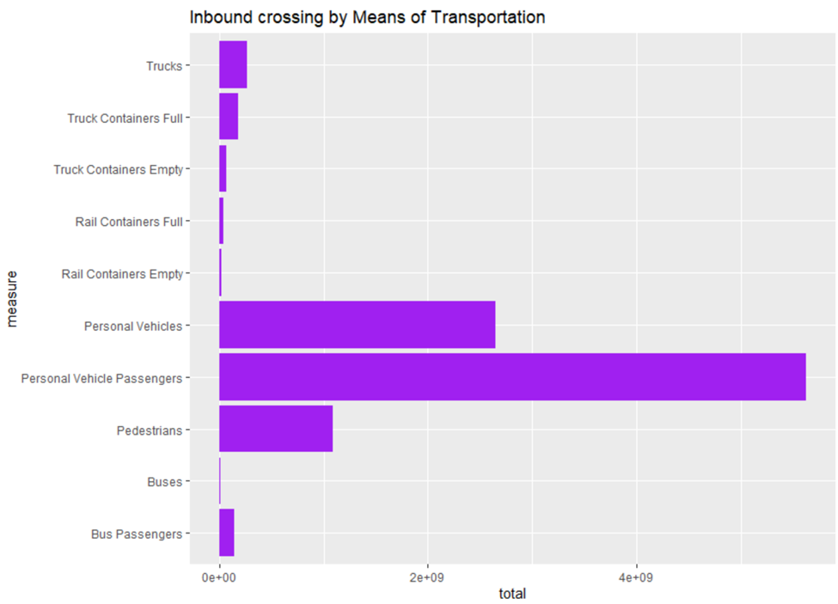
Top Ten Measures of Transportation
I sorted the measure of transportation.
I plotted the top ten inbound crossing measure of transportation and we can see that personal vehicle passengers are the highest.

Slide 14
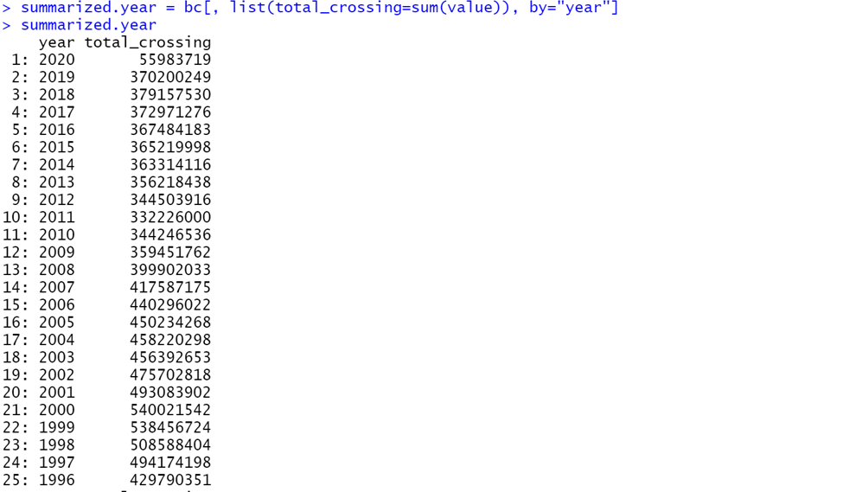
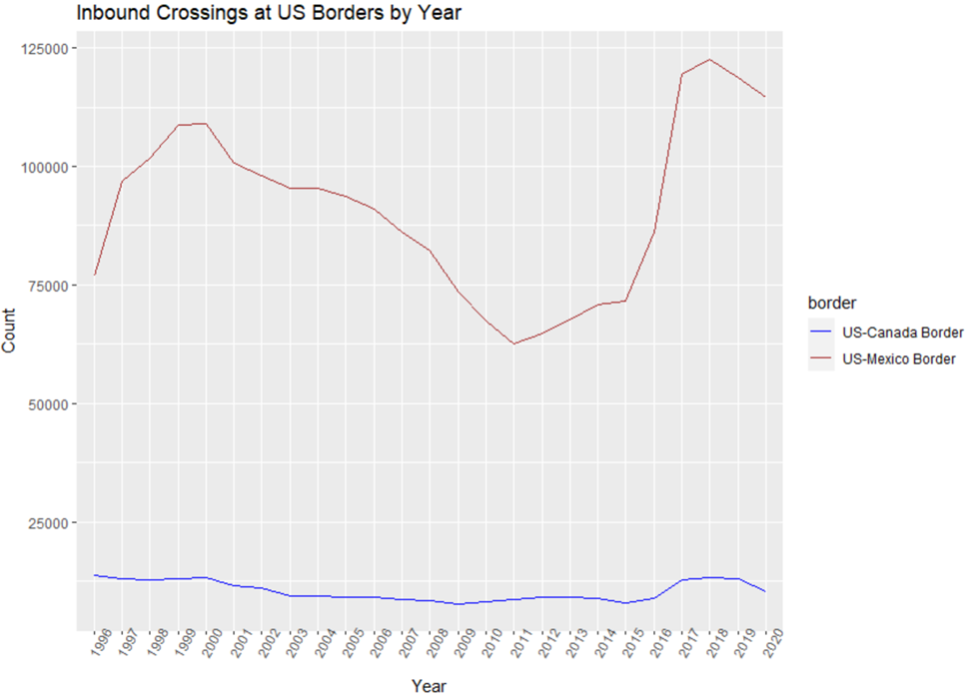
Annual Inbound Traffic
The numbers over the years at US-Canada Border portray to be steady whereas from the Mexico Border, we see a huge peak from 2016. When President Trump came into office and proposed the border wall, Hispanics started flooding into the country.

Slide 15
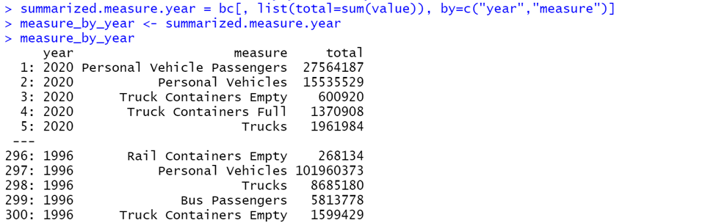
Inbound Traffic At US Borders by Year and Measure Of Transportation

Slide 16
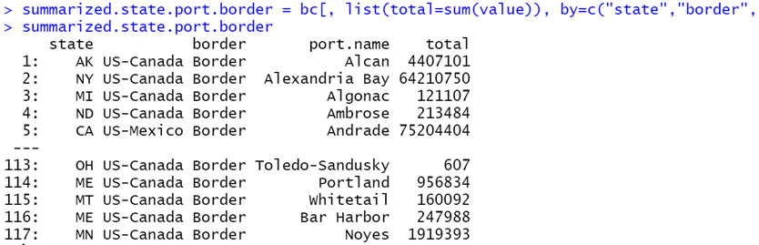
The Inbound Traffic At US Borders by States, Borders and Ports

Slide 17
CONCLUSION
Though the US and Canada Border are associated with 12 out of the 16 border States, we observed that most of the inbound crossings takes place at the southern US and Mexico Border.
Also, noted is the fact that passenger vehicles are used for most of the incoming crossings into the US. This is followed by personal vehicles and thirdly by pedestrians who most likely crossed in by foot.
There was no record of crossing into the US through underground tunnels. We observed from the visualizations that most crossing occurred at Texas and specifically at El Paso, San Ysidro and Laredo ports.
The trend over the years from 1996 to February 2020 shows a sharp drop of inbound crossing between 2010 and 2015, thereafter, in 2016, there was a huge peak in the numbers flooding the country especially through the US and Mexico Border.
These trends obviously reflect changes in the US Mexico immigration policy decisions which led to the building of wall across the southern border states with Mexico to control the flow of inbound traffic.

Slide 18
References
Akhil. (2019, August 21). Border Crossing Entry Data. Retrieved May 20, 2020, from https://www.kaggle.com/akhilv11/border-crossing-entry-data
Bischl, B., Lang, M., & Kotthoff, L. (n.d.). Learning Tasks. Retrieved June 3, 2020, from https://mlr.mlr-org.com/articles/tutorial/task.html
Border Crossing/Entry Data. (n.d.). Retrieved May 24, 2020, from https://www.bts.gov/content/border-crossingentry-data
Murray. (n.d.). Border Crossings Project. Retrieved June 15, 2020, from https://rstudio-pubs-static.s3.amazonaws.com/539991_356f6cb96e2f4062af09765937e4eea7.html

